Slide 1
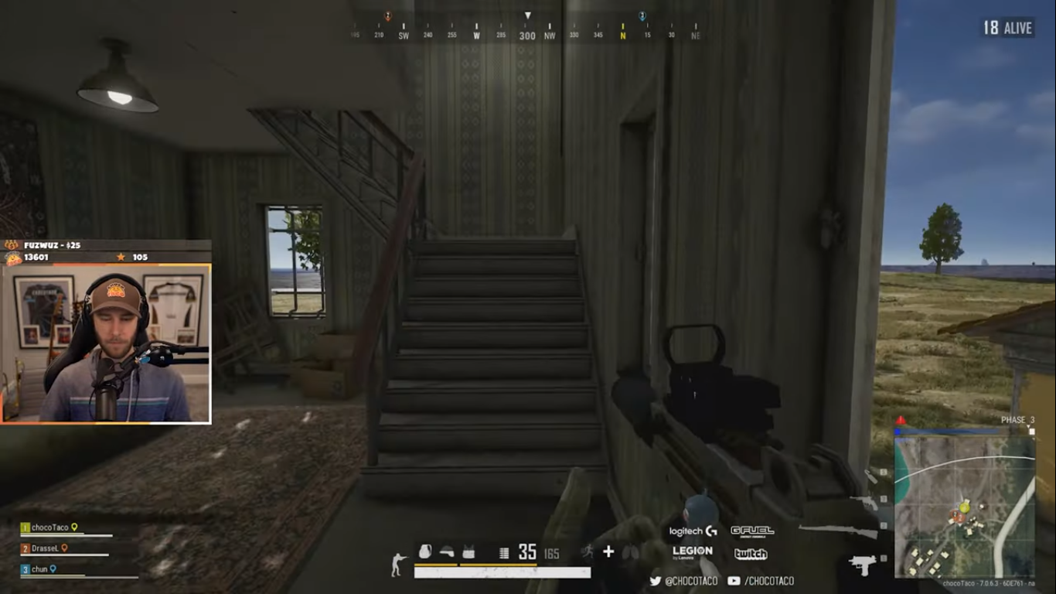

Hmm, I Like Pizzas. I Prefer dominos. What about you? Chat..

Slide 2
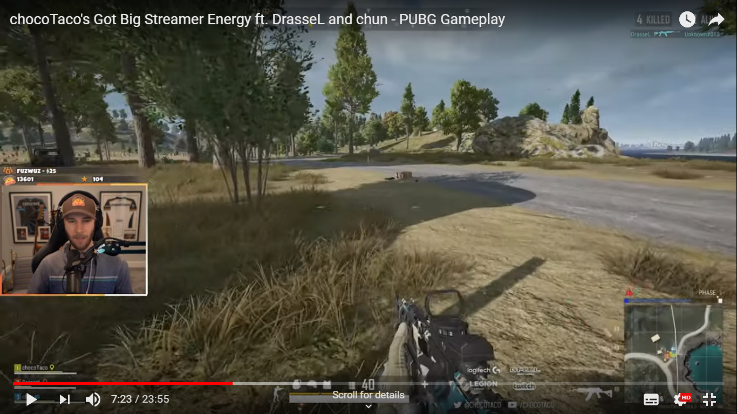

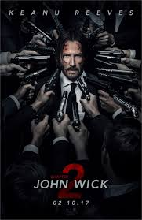
Do you guys like Keanu reeves? I am sorry guys. What I am even asking! Everybody loves Keanu reeves. John Wick is my favorite movie.

Slide 3
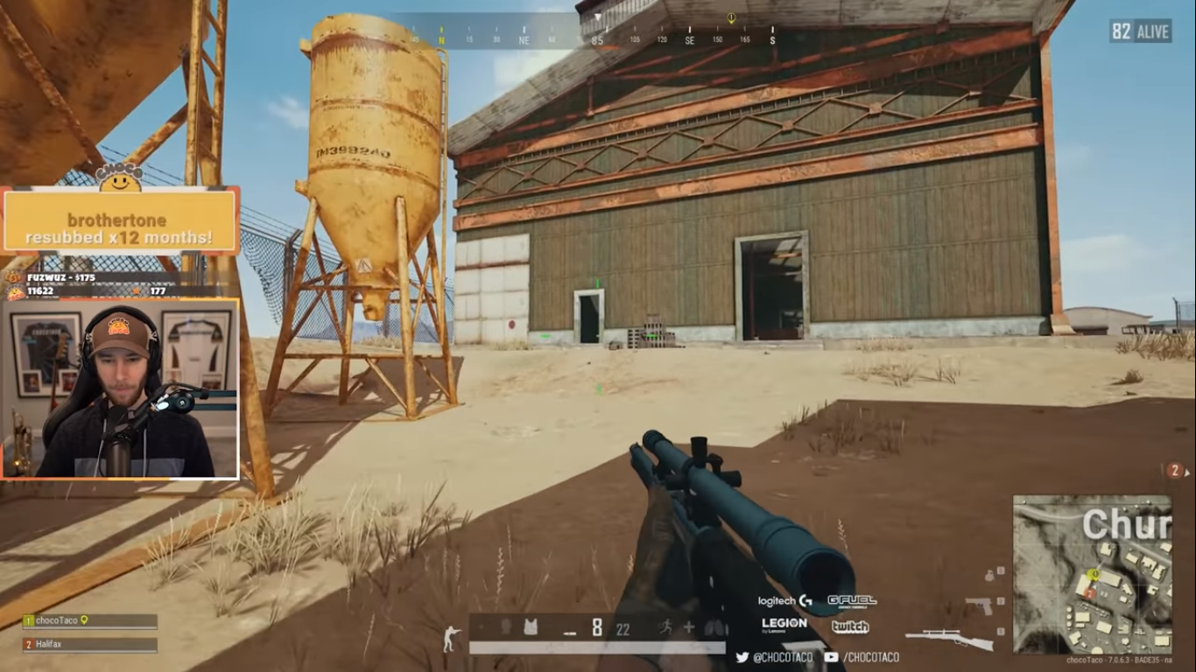
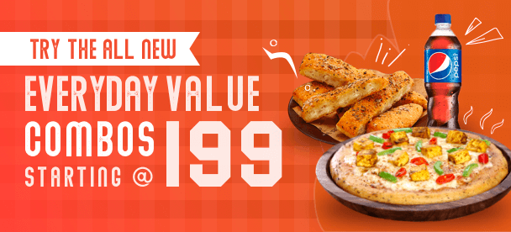
I’m so hungry right now. Wish there were some good combo pack.

Slide 4
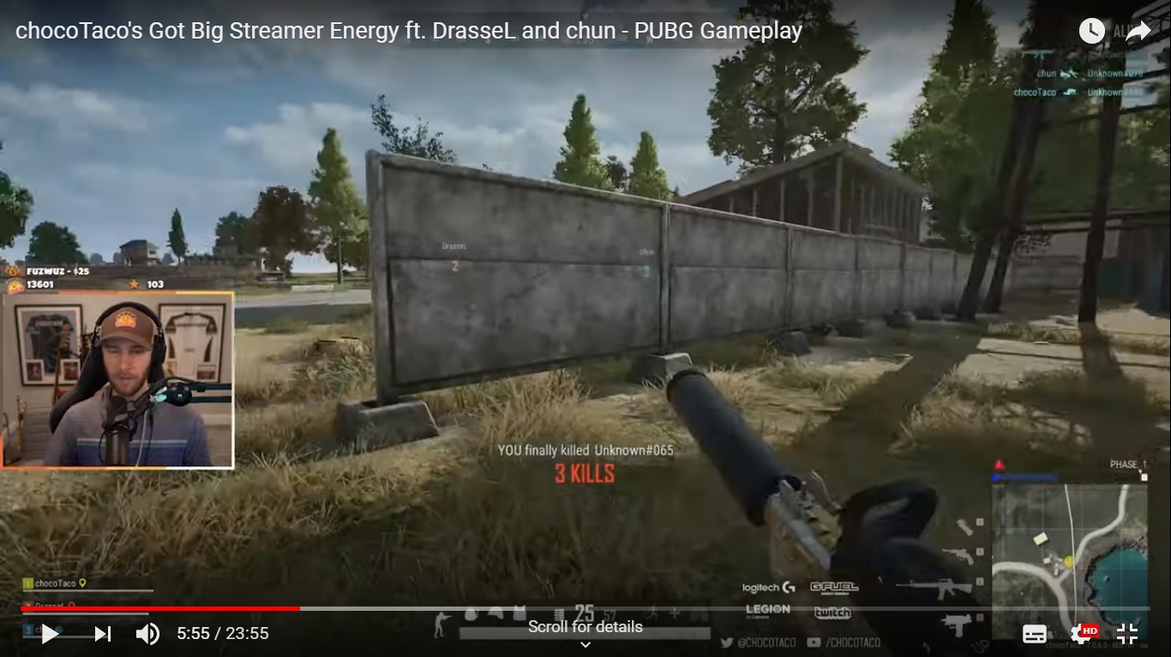

I've been to Starbucks.

